Slide 1

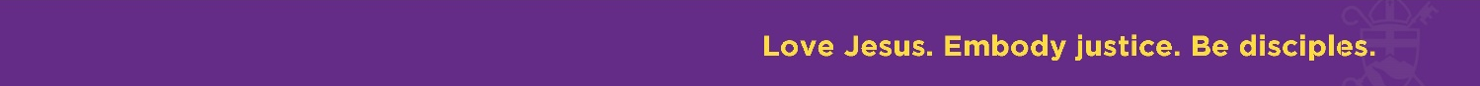
What Should We Expect from a Mutual Ministry Review Experience
The Reverends Will Dickinson and Shirley Smith Graham
Revised February 17, 2026

Slide 2
What Should I Expect
Inspiration
Spirit of trust and confidentiality
Constructive communications (I statements, hearing while seeking to understand, working together against challenges)
Fun
Deeper connections with one another as disciples following Jesus

Slide 3
What Does an MMR Look Like?
Three to four hour facilitated conversation (breaks included)
At your church or in another comfortable space
Prayer to begin and end, and as needed
Opportunity for all voices to share from their perspective
For MMRs for Priest-in-Charge converting to Rector, follow-up conversation between Diocesan Transition Ministers and wardens and priest

Slide 4
How Do We Get Ready?
The Priest and Wardens identify a time to do the Mutual Ministry Review (usually annual anniversary).
They choose and meet with the facilitator, who will ask what they want to get out of the experience.
Based on the conversation, the facilitator will propose a format.
Show up with a supportive, brave and loving heart

Slide 5
Goals of Mutual Ministry Review
Gather representatives of the shared ministry: priest and vestry
Create a safe place for people to speak and be heard
Identify how God is working among us
Develop a shared perspective of the ministries of this church
Equip leaders of this church – shared perspective, trust, planned actions and mobilization for the future
Empower each participants to be a “I” in community with other “I”s
Increase understanding of how information gets shared and how decisions get made
Be descriptive, not evaluative, as we build a shared perspective

Slide 6
Goals of Mutual Ministry Review (cont.)
To assess what actions might be best appropriate for our future
Create opportunities for adjustments
Reflect on how vestry, staff and volunteer ministries can be organized to support our missional goals
Get people organized to work the issues vs. being hard on people
Encourage unified leadership among whom there will be differences
Refine our mission and our missional future
Create a yearly opportunity to celebrate our mutual ministry!

