Slide 1


Lisa Kimball, Ph.D.
Vice President for Lifelong Learning
James Maxwell Professor of Christian Formation
Virginia Theological Seminary
Baptized for Life!
The 231st Annual Convention of the Episcopal Diocese of Virginia
Love Jesus. Embody justice. Be disciples.
November 6 – 8, 2025

Slide 2

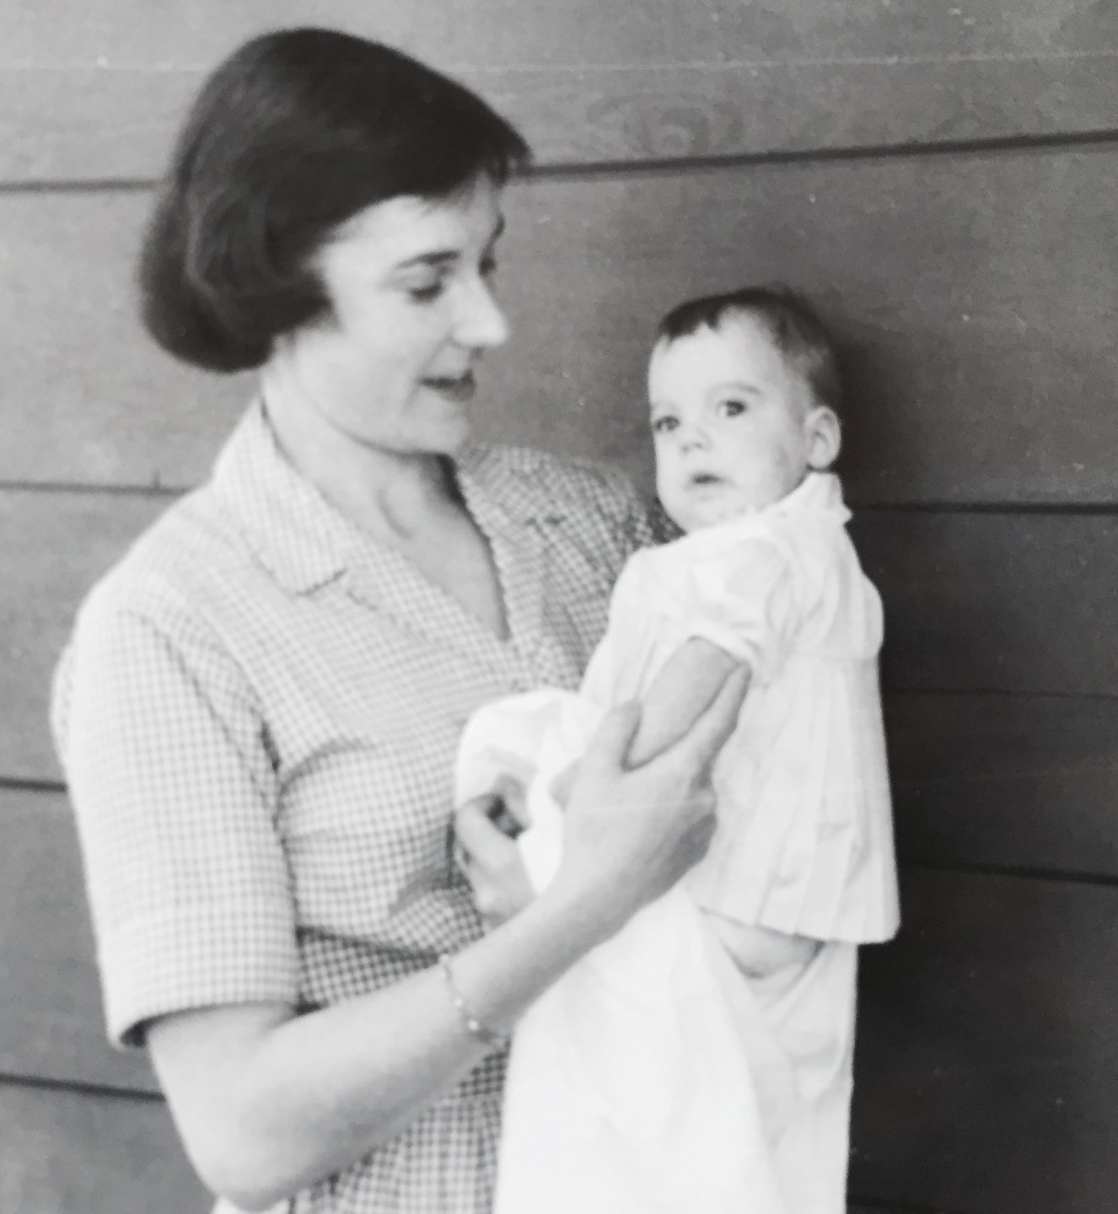

Slide 3
The Collect – All Saints' Day
Almighty God, you have knit together your elect in one communion and fellowship in the mystical body of your Son Christ our Lord: Give us grace so to follow your blessed saints in all virtuous and godly living, that we may come to those ineffable joys that you have prepared for those who truly love you; through Jesus Christ our Lord, who with you and the Holy Spirit lives and reigns, one God, in glory everlasting.
Amen.

Slide 4
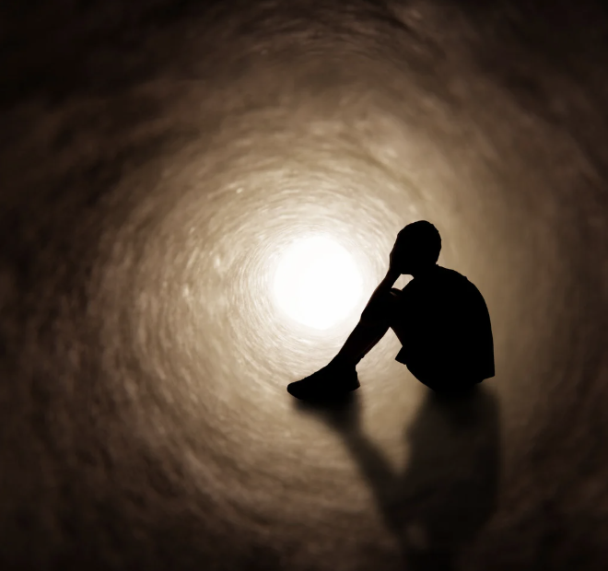


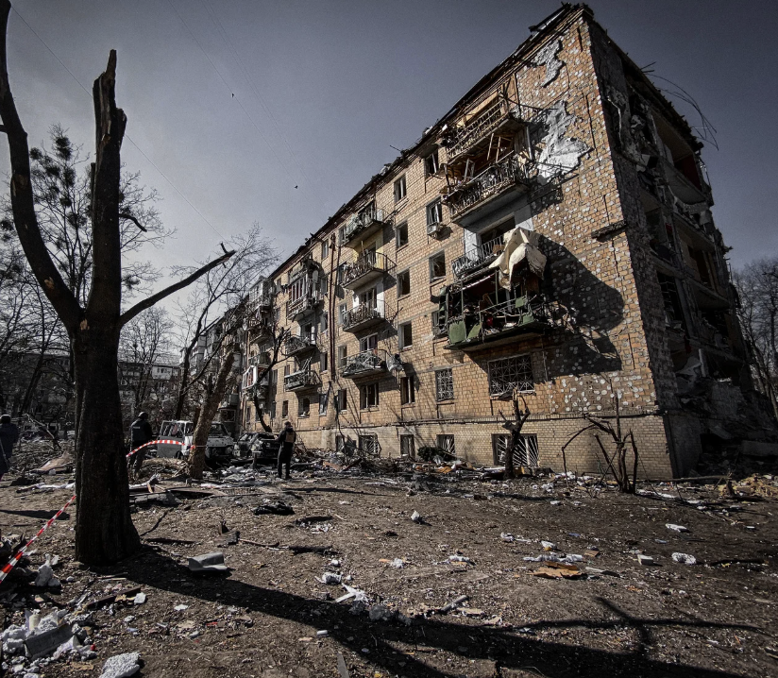



Slide 5


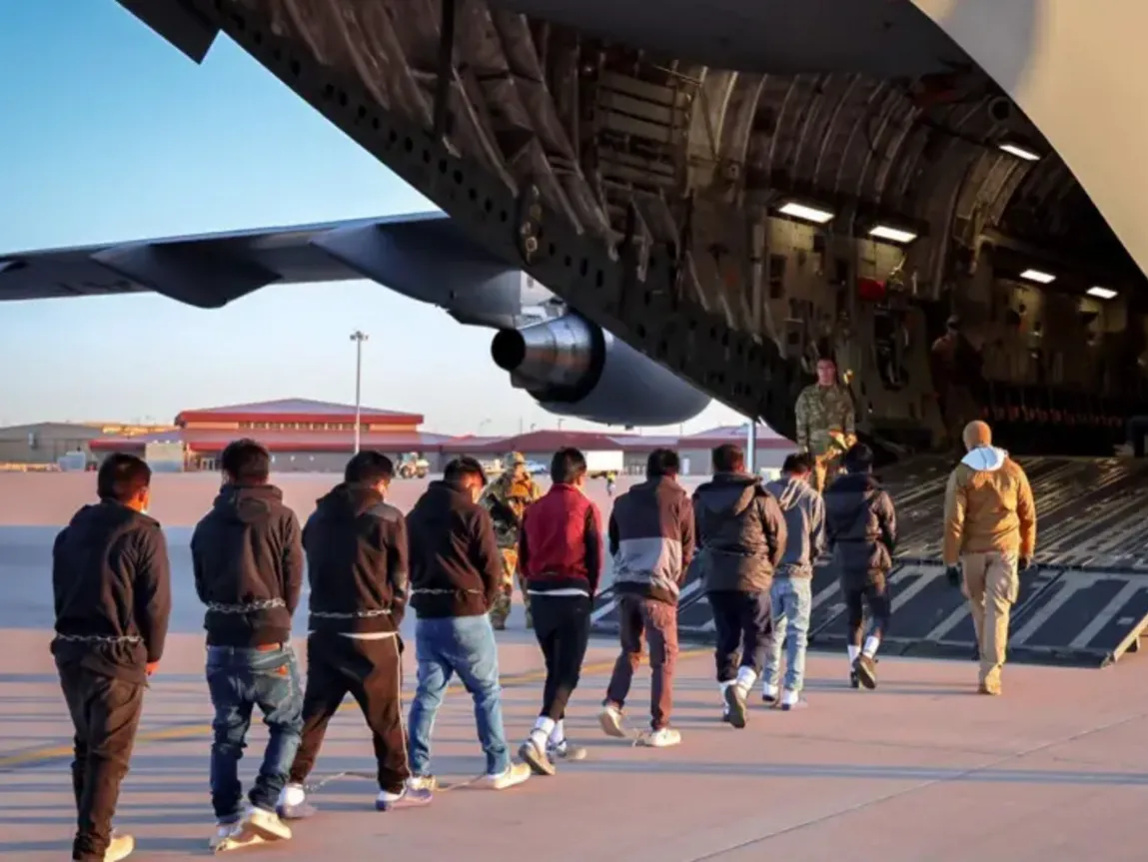

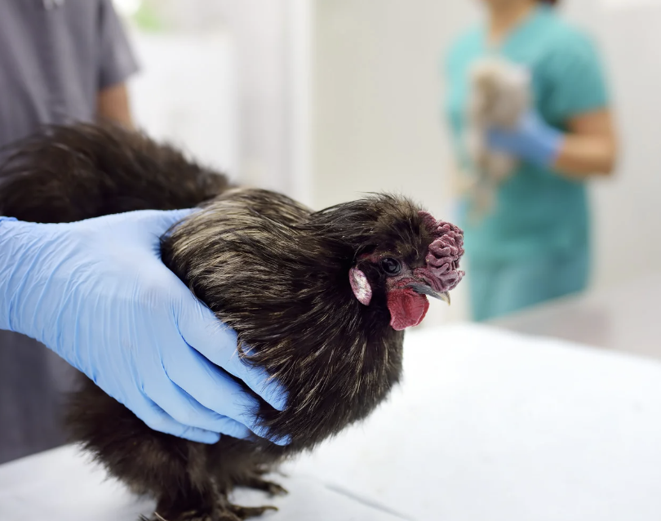

Slide 6
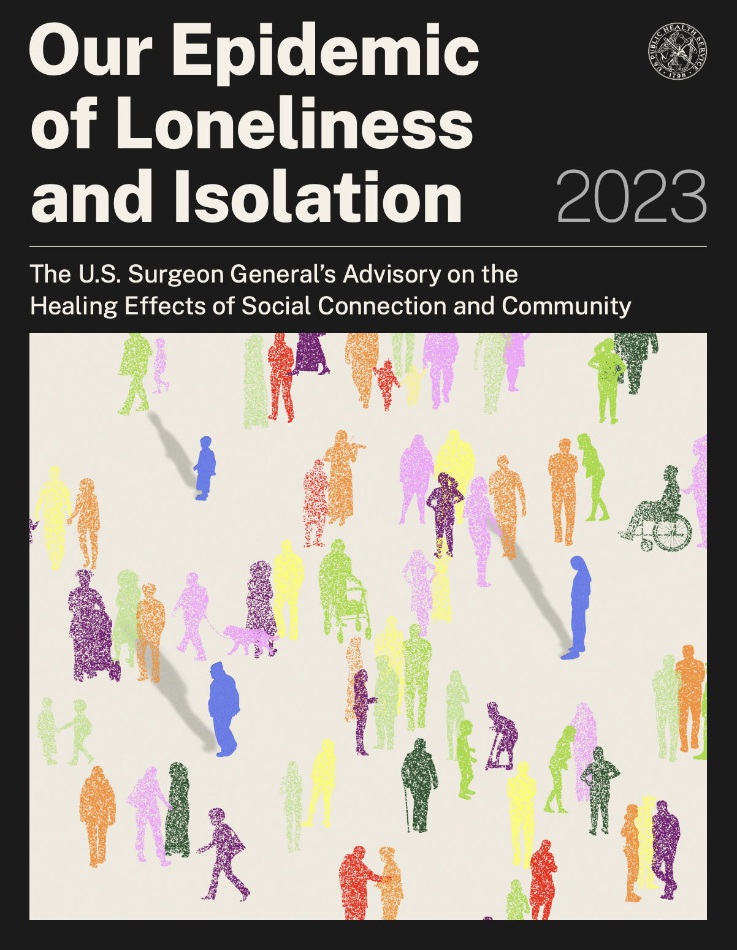



Slide 7
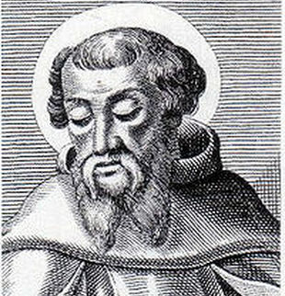

Irenaeus, c. 125 – c. 202 AD
“The glory of God is the [man] human fully alive.”
Photo Credit: Catholic Faith & Reason

Slide 8
The gathering of the baptized is not a convocation of those who are privileged, elite, and separate,
but of those who have accepted what it means to be in the heart of a needy, contaminated, messy world. (Rowan Williams, Being Christian, 6)

Slide 9


Slide 10


Slide 11


Slide 12
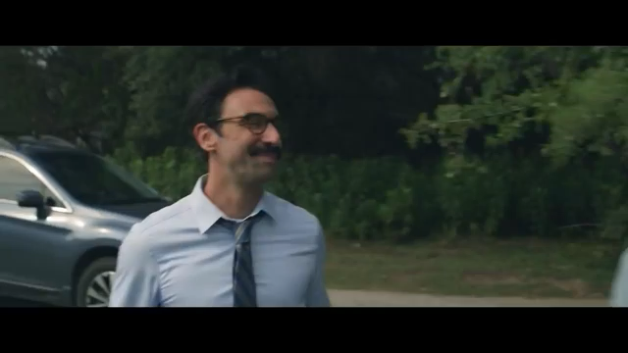

Slide 13
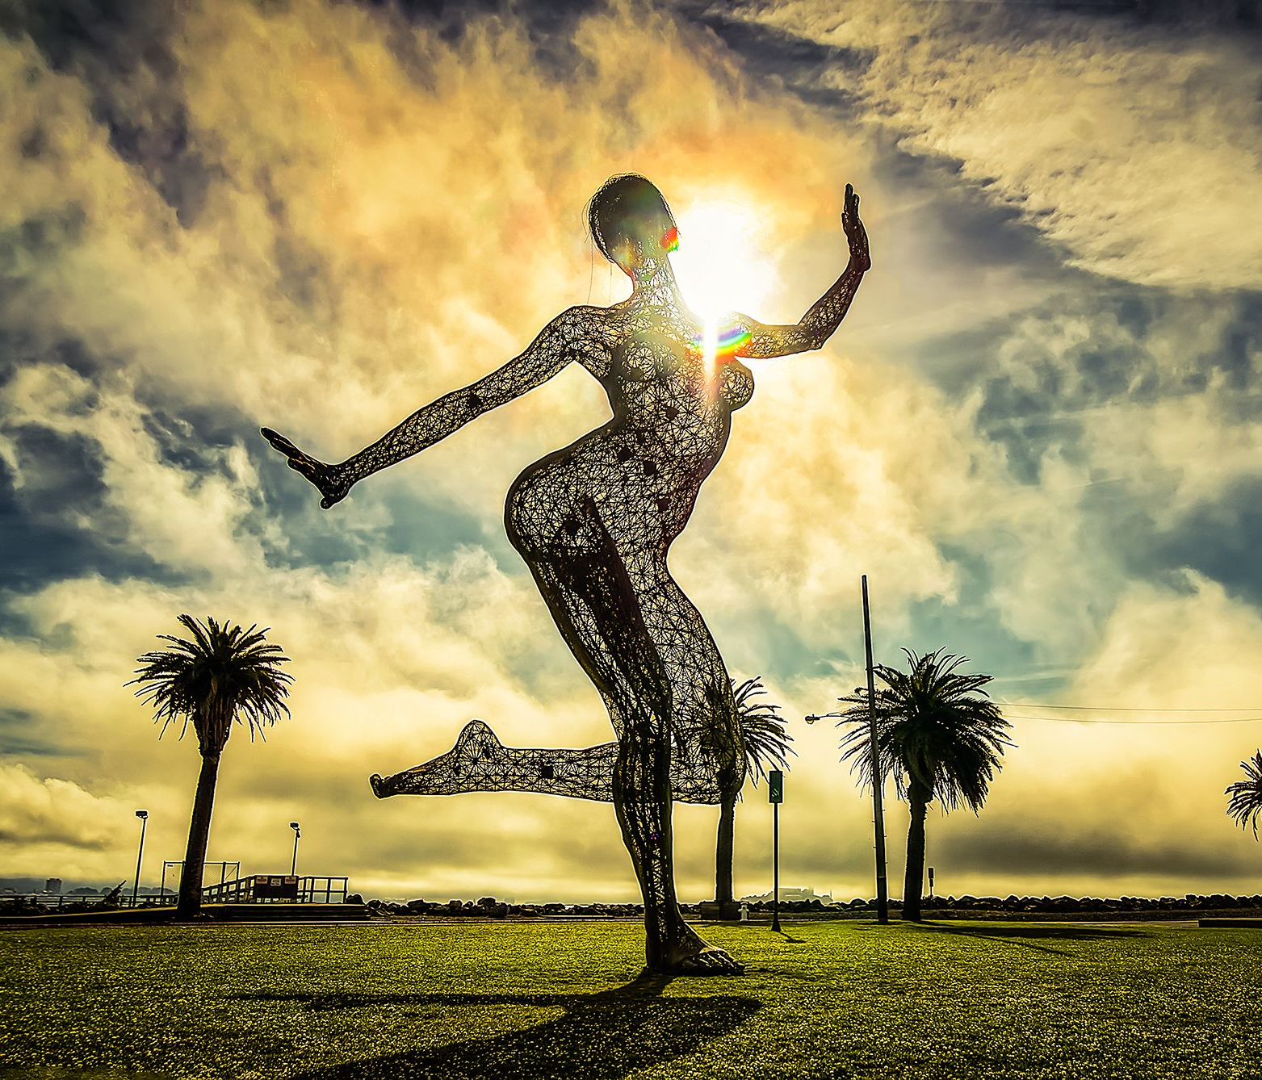
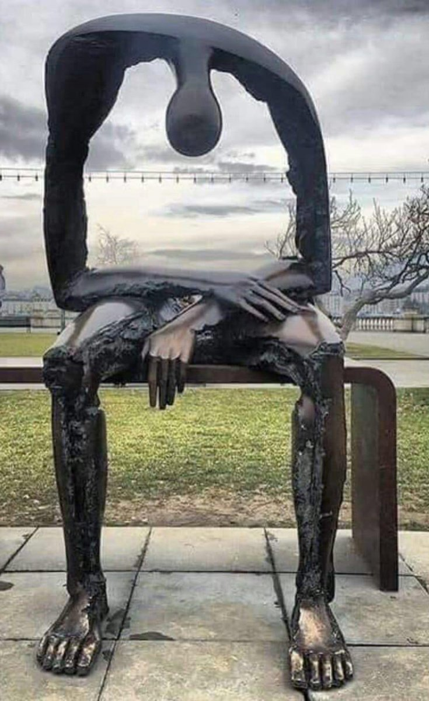

Slide 14
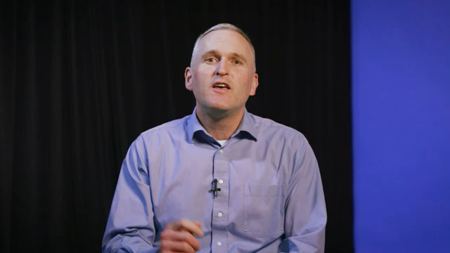

Slide 15
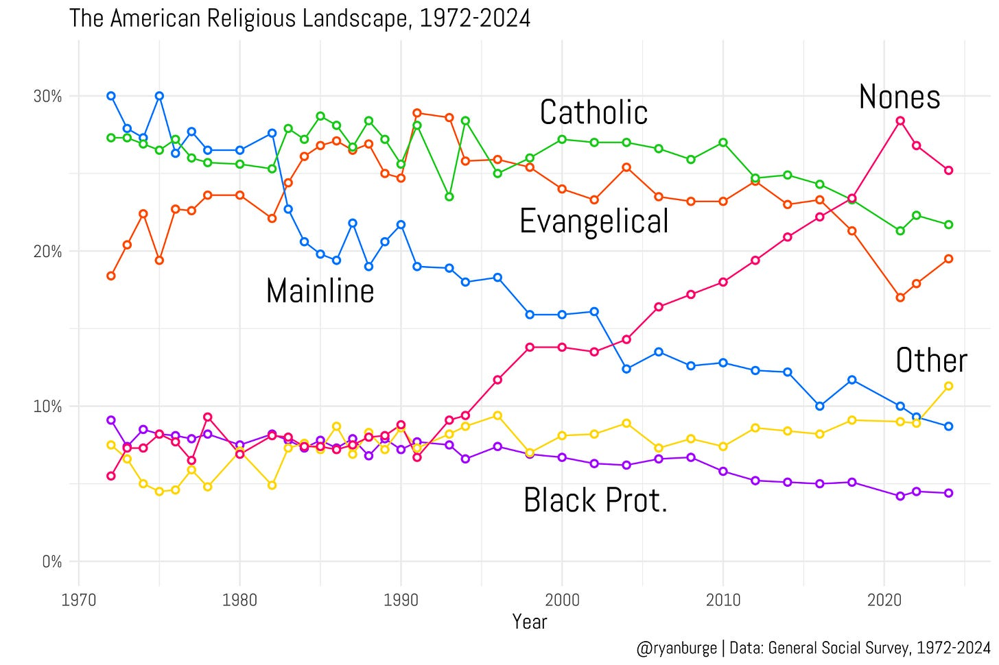

Slide 16
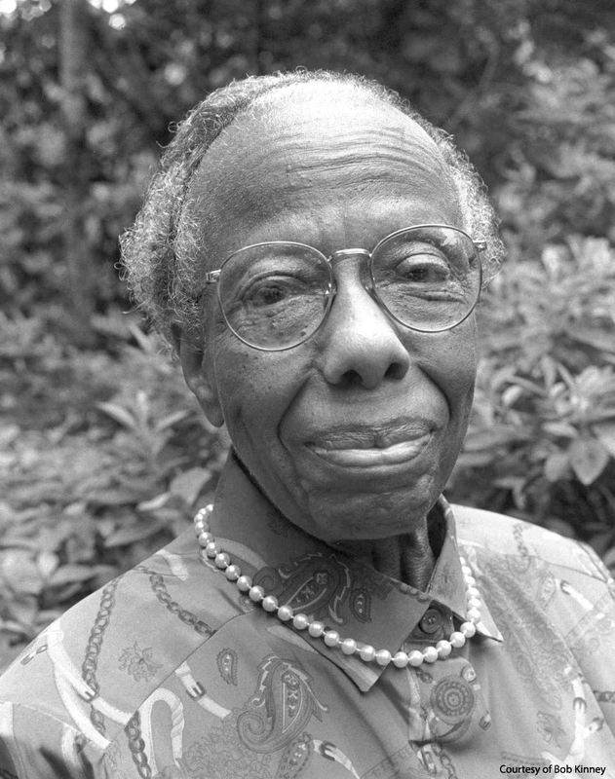
“The important question to ask is NOT, 'What do you believe?’
BUT
'What difference does it make that you believe?'” (p. 105)
Source: Dozier, V. J. (1991). The Dream of God: A call to return. Cambridge, Massachusetts: Cowley Publications.

Slide 17
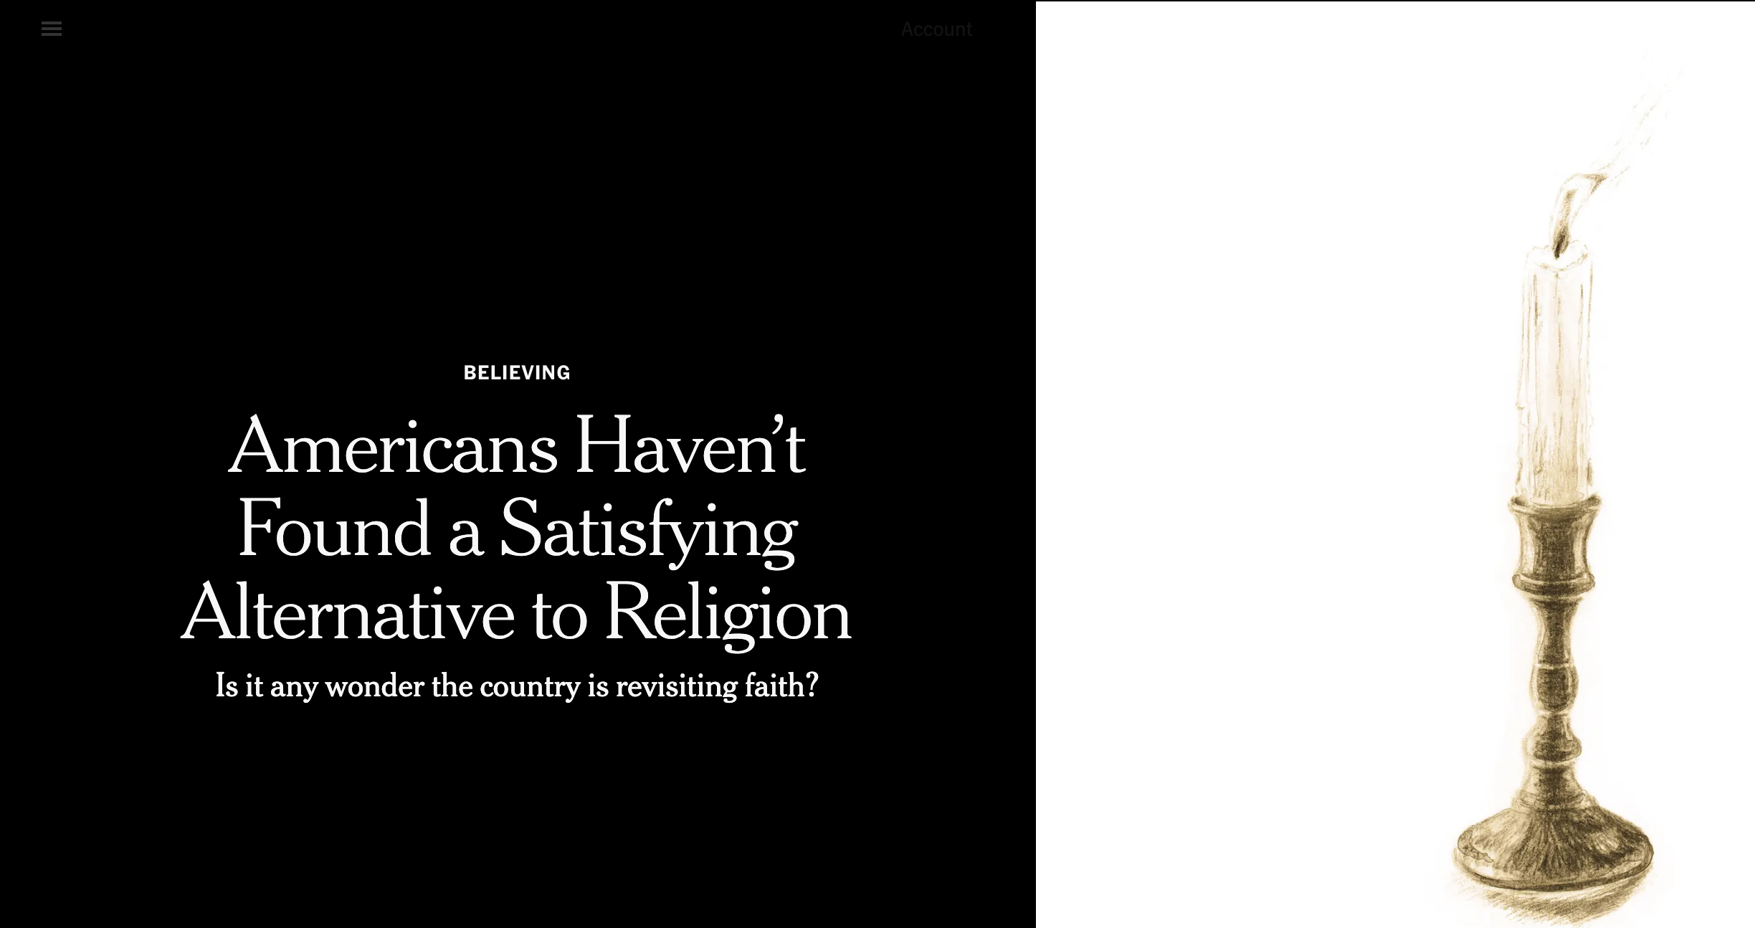
Lauren Jackson – New York Times, April 18, 2025

Slide 18

Ease divisions. Prevent violence. Solve problems.
Notes:
Tim Shriver., American disability rights activist, educator & film producer. Our disagreements aren’t causing the divisions in our country; it’s what we do when we disagree.

Slide 19


DIGNITY
CONTEMPT
Notes:
Do we treat the other side with dignity or do we treat them with contempt? The first brings us together; the second drives us apart.
We created The Dignity Index to show us the difference.

Slide 20
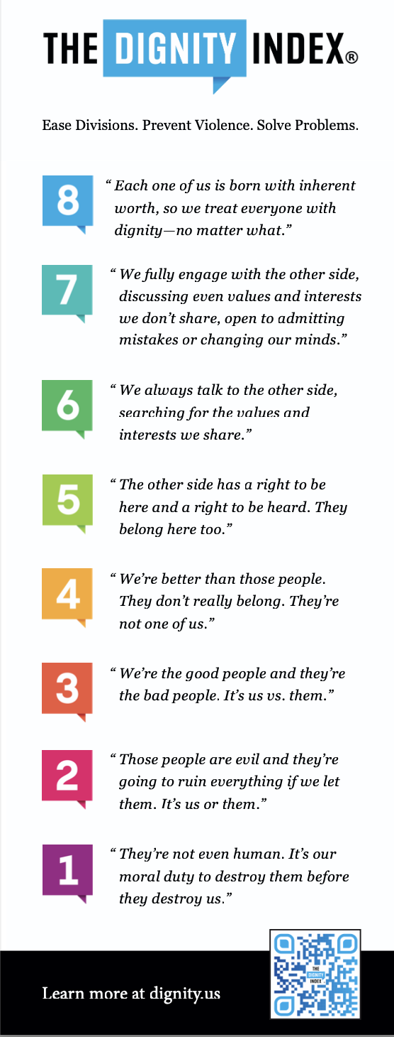

Slide 21

Do you not know that all of us who have been baptized into Christ Jesus were baptized into his death?
Therefore, we have been buried with him by baptism
into death, so that, just as Christ was raised from the
dead by the glory of the Father, so we too might walk
in newness of life. (Romans 6: 3-4)

Slide 22

3 years in seminary, 30 minutes to prepare for baptism
Put the unconverted in charge of conversion
Ask congregations to take vows they cannot fulfill
Baptismal ministry by committee
Where do we fall short?
Notes:
We can and we MUST do better to live into our baptismal theology and ecclesiology

Slide 23
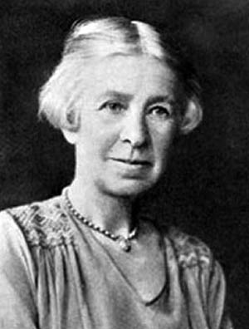
“The two things that the laity want from the priesthood are spiritual realism and genuine love of souls…God is the interesting thing about religion, and people are hungry for God. But only a priest whose life is soaked in prayer, sacrifice, and love can, by his own spirit of adoring worship, help us to comprehend [God].”
Evelyn Underhill, Letter to Archbishop Lang of Canterbury, c1930
Photo Credit: The Episcopal Church

Slide 24
The absence in many modern churches of significant and deeply rooted orthodoxy in baptismal theology and practice turns seminaries into catechumenates, ordination into baptism, and clergy into "first-class" ecclesiastical citizens freed of obligations to the tradition and to proletarian communities of the merely baptized.
Anglican Theological Review, 66
(Suppl. Series 9): 1, 1984; 44.

Slide 25
“There are no
second-class citizens in the household of God. Religious authority comes with baptism, and it is nurtured by prayer, worship, bible study, life together.” (p. 115)
“What happens on Sunday morning is not half so important as what happens on Monday morning. In fact, what happens
on Sunday morning is judged by what happens on Monday morning.” (p. 115)
Source: Dozier, V. J. (1988). The calling of the laity: Verna Dozier's anthology. Washington, DC: The Alban Institute.

Slide 26
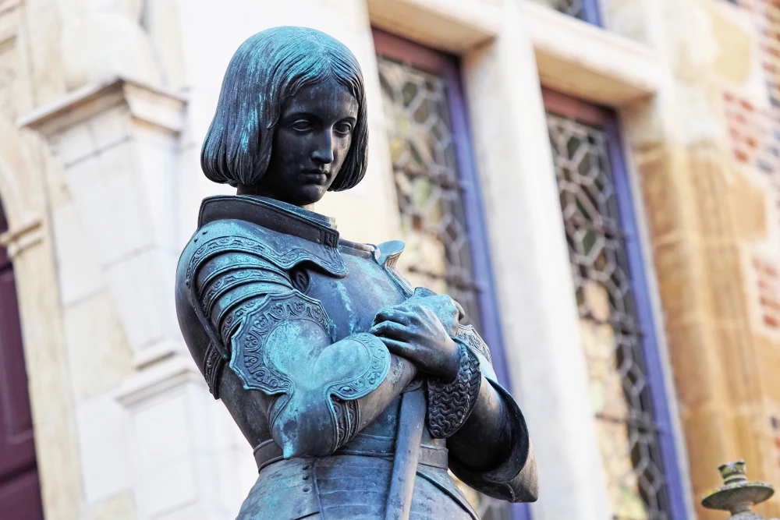
Joan of Arc:
“I am not afraid. I was born for this.”
A statue of Joan of Arc in Orleans, France. Guillaume Souvant / AFP via Getty Images file
Notes:
One historian … At her trial she answered that she did not fear soldiers, for her way had been prepared; because, if there did happen to be soldiers along the way, she had God, her Lord, who would make a way for her to go to the lord Dauphin, and that she had been born to do this.

Slide 27
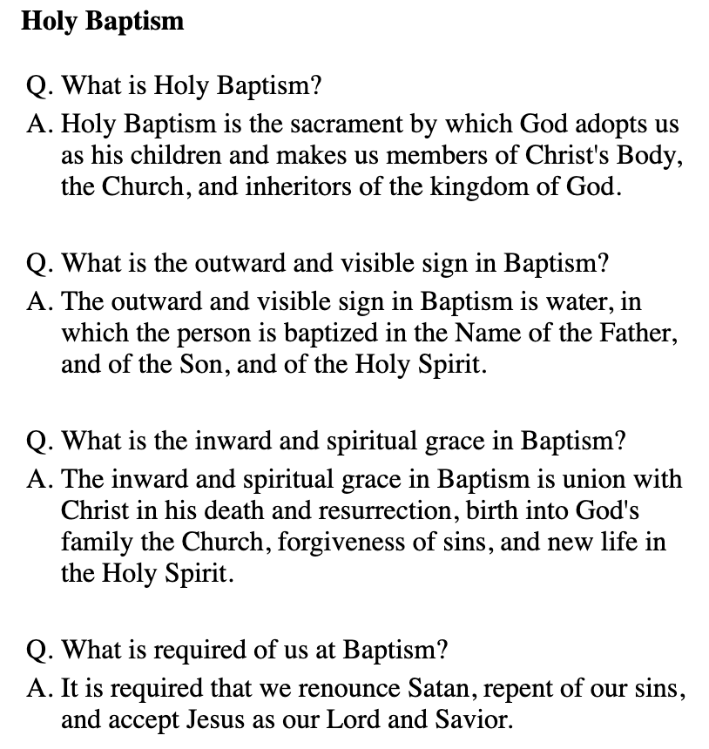

Slide 28
Q. Who are the ministers of the Church?
The ministers of the Church are lay persons, bishops, priests, and deacons.
Q. What is the ministry of the laity?
A. …to represent Christ and his Church; to bear witness to him wherever they may be; and, according to the gifts given them, to carry on their place in the life, worship, and governance of the Church.

Slide 29



Slide 30
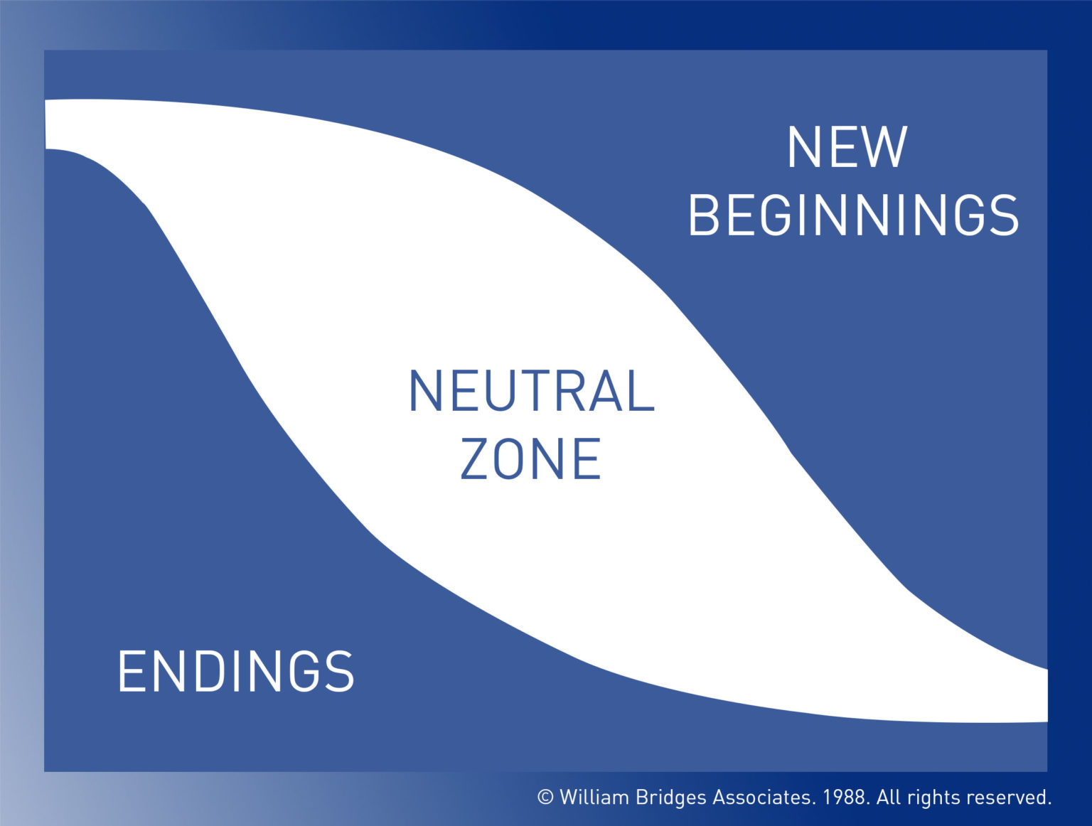
William Bridges’ Transitions Model

Slide 31
ENDINGS – Losing, letting go
They said to Moses, “Was it because there were no graves in Egypt that you have taken us away to die in the wilderness? What have you done to us, bringing us out of Egypt? Is this not the very thing we told you in Egypt, ‘Let us alone so that we can serve the Egyptians’? For it would have been better for us to serve the Egyptians than to die.
in the wilderness.” But Moses said to the people, “Do not be afraid, stand firm, and see the deliverance that the Lord will accomplish for you today, for the Egyptians whom you see today you shall never see again. The Lord will fight for you, and you have only to keep still.” (Exodus 14:11-14)

Slide 32
NEUTRAL ZONE – In-between, core of transition, confusion, distress, rich learning
For now we see only a reflection, as in a mirror, but then we will see face to face. Now I know only in part; then I will know fully, even as I have been fully known. And now faith, hope, and love remain, these three, and the greatest of these is love.
(I Cor 13:12-13)
Notes:
Difference between joy and happiness: joy = deep, internal, abiding contentment. Happiness = episodic emotion in response to external circumstances

Slide 33
NEW BEGINNINGS –
(Re)new(ed) identity, clarity of purpose and belonging
Then I saw a new heaven and a new earth, for the first heaven and the first earth had passed away, and the sea was no more. And I saw the holy city, the new Jerusalem, coming down out of heaven from God, prepared as a bride adorned for her husband.
And I heard a loud voice from the throne saying,
“See, the home of God is among mortals.
He will dwell with them;
they will be his peoples, and God himself will be with them and be their God; he will wipe every tear from their eyes.
Death will be no more;

Slide 34
NEW BEGINNINGS –
(Re)new(ed) identity, clarity of purpose and belonging
mourning and crying and pain will be no more, for the first things have passed away.”
And the one who was seated on the throne said, “See, I am making all things new.” Also he said, “Write this, for these words are trustworthy and true.” Then he said to me, “It is done! I am the Alpha and the Omega, the Beginning and the End. (Revelation 21:1-6)

Slide 35
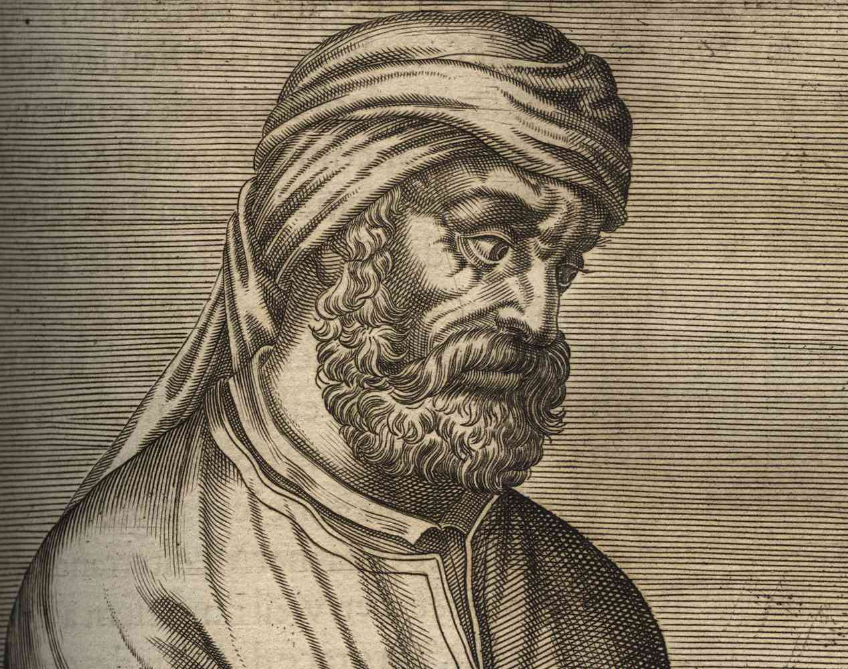
Tertullian –
Father of Latin Theology c.155 AD – c.220 AD
"Christians are made, not born"
(Apol., xviii)

Slide 36

You may have all the kingdoms of the world if you fall down and worship me.
Away with you, Satan! Worship the Lord your God, and serve only him.
Do you renounce Satan and all the spiritual forces of wickedness that rebel against God?
I renounce them.

Slide 37
Command these stones to become loaves of bread.
One does not live by bread alone, but by every word that comes from the mouth of God.
Do you renounce the evil powers of this world which corrupt and destroy the creatures of God?
I renounce them.

Slide 38
Throw yourself down from the pinnacle & let the angels catch you.
Do not put the Lord your God to the test.
Do you renounce all sinful desires that draw you from the love of God?
I renounce them.

Slide 39
Do you turn to Jesus Christ and accept him as your Savior?
Do you put your whole trust in his grace and love?
Do you promise to follow and obey him as your Lord?
I do.
I do.
I do.

Slide 40
Will you who witness these vows do all in your power to support these persons in their life
in Christ?
We
will.
Let us join with those who are committing themselves to Christ and renew our own baptismal covenant.

Slide 41

Discipleship Process*
Inquiry
Rite of Welcome
Formation
Rite of Enrollment
Intense Preparation
Baptism, Confirmation, Reception, Reaffirmation
Baptismal Living
Celebration of Vocation
Beginnings of faith
Scripture, Community
Liturgy, Mission
Prayer and Discernment
Reflecting on
Sacramental Experience
*Adapted from the catechumenate
A Journey in faith that takes as long as it takes;
lay led and supported by sponsors.

Slide 42



BAPTISM
CONFIRMATION
REAFFIRMATION
RECEPTION

Slide 43


Slide 44
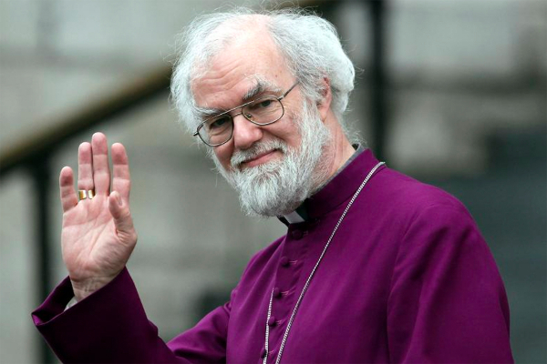
“The purpose of the church is to form people into the kinds of people who can receive the gifts God wants to give.”
– Rowan Williams

Slide 45

“We do not
half-ass baptize people.”
Bishop Barbara Harris

Slide 46


Slide 47
Lisa Kimball, Ph.D.
Vice President for Lifelong Learning
James Maxwell Professor of Christian Formation
Virginia Theological Seminary
Baptized for Life!
Our Call to Action: Being Faithful Today
The 231st Annual Convention of the Episcopal Diocese of Virginia
Love Jesus. Embody justice. Be disciples.
November 6 – 8, 2025

Slide 48


OVERNIGHT?

Slide 49

“Nothing living lives alone.”
– Margaret Wheatley, Who Do You Choose To Be? (2023)
Interconnectedness is a relationship among equals bound together in networks of mutuality

Slide 50
“Nothing living lives alone.”
– Margaret Wheatley, Who Do You Choose To Be? (2023)
Interconnectedness is a relationship among equals bound together in networks of mutuality
Collaboration is the process that creates a thriving ecosystem

Slide 51
“Nothing living lives alone.”
– Margaret Wheatley, Who Do You Choose To Be? (2023)
Interconnectedness is a relationship among equals bound together in networks of mutuality
Collaboration is the process that creates a thriving ecosystem
Greed destroys it

Slide 52

Build a team ...
The parish is the unit of change
It all begins and ends in prayer
Be the church

Slide 53

Counterintuitive Call to Action

Slide 54
Counterintuitive Call to Action
Prevent burnout from mission drift & over-functioning

Slide 55
Counterintuitive Call to Action
Prevent burnout from mission drift & over-functioning
Discernment over decision-making

Slide 56
Counterintuitive Call to Action
Prevent burnout from mission drift & over-functioning
Discernment over decision-making
Join God's dream of reconciliation and renewal

Slide 57
Counterintuitive Call to Action
Prevent burnout from mission drift & over-functioning
Discernment over decision-making
Join God's dream of reconciliation and renewal
Equip the baptized to be church where they are

Slide 58

LISTENING moves us closer. It helps us become more whole, more healthy, more holy. Not listening creates fragmentation, and fragmentation is the root of all suffering,” ... “you can’t hate someone whose story you know.”
Margaret Wheatley, Finding Our Way)

Slide 59
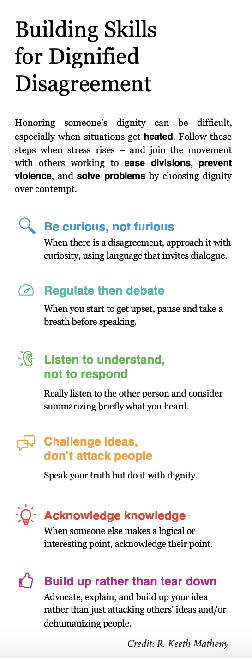

Slide 60

Increase social connection
Double-down on Christian formation
Celebrate Life!

Slide 61

For reflection:
1. How can you strengthen the social fabric of your congregation?
2. What does your congregation need to foster deeper discipleship of all ages?
3. What is one opportunity for joy and celebration to which you are looking forward?

Slide 63


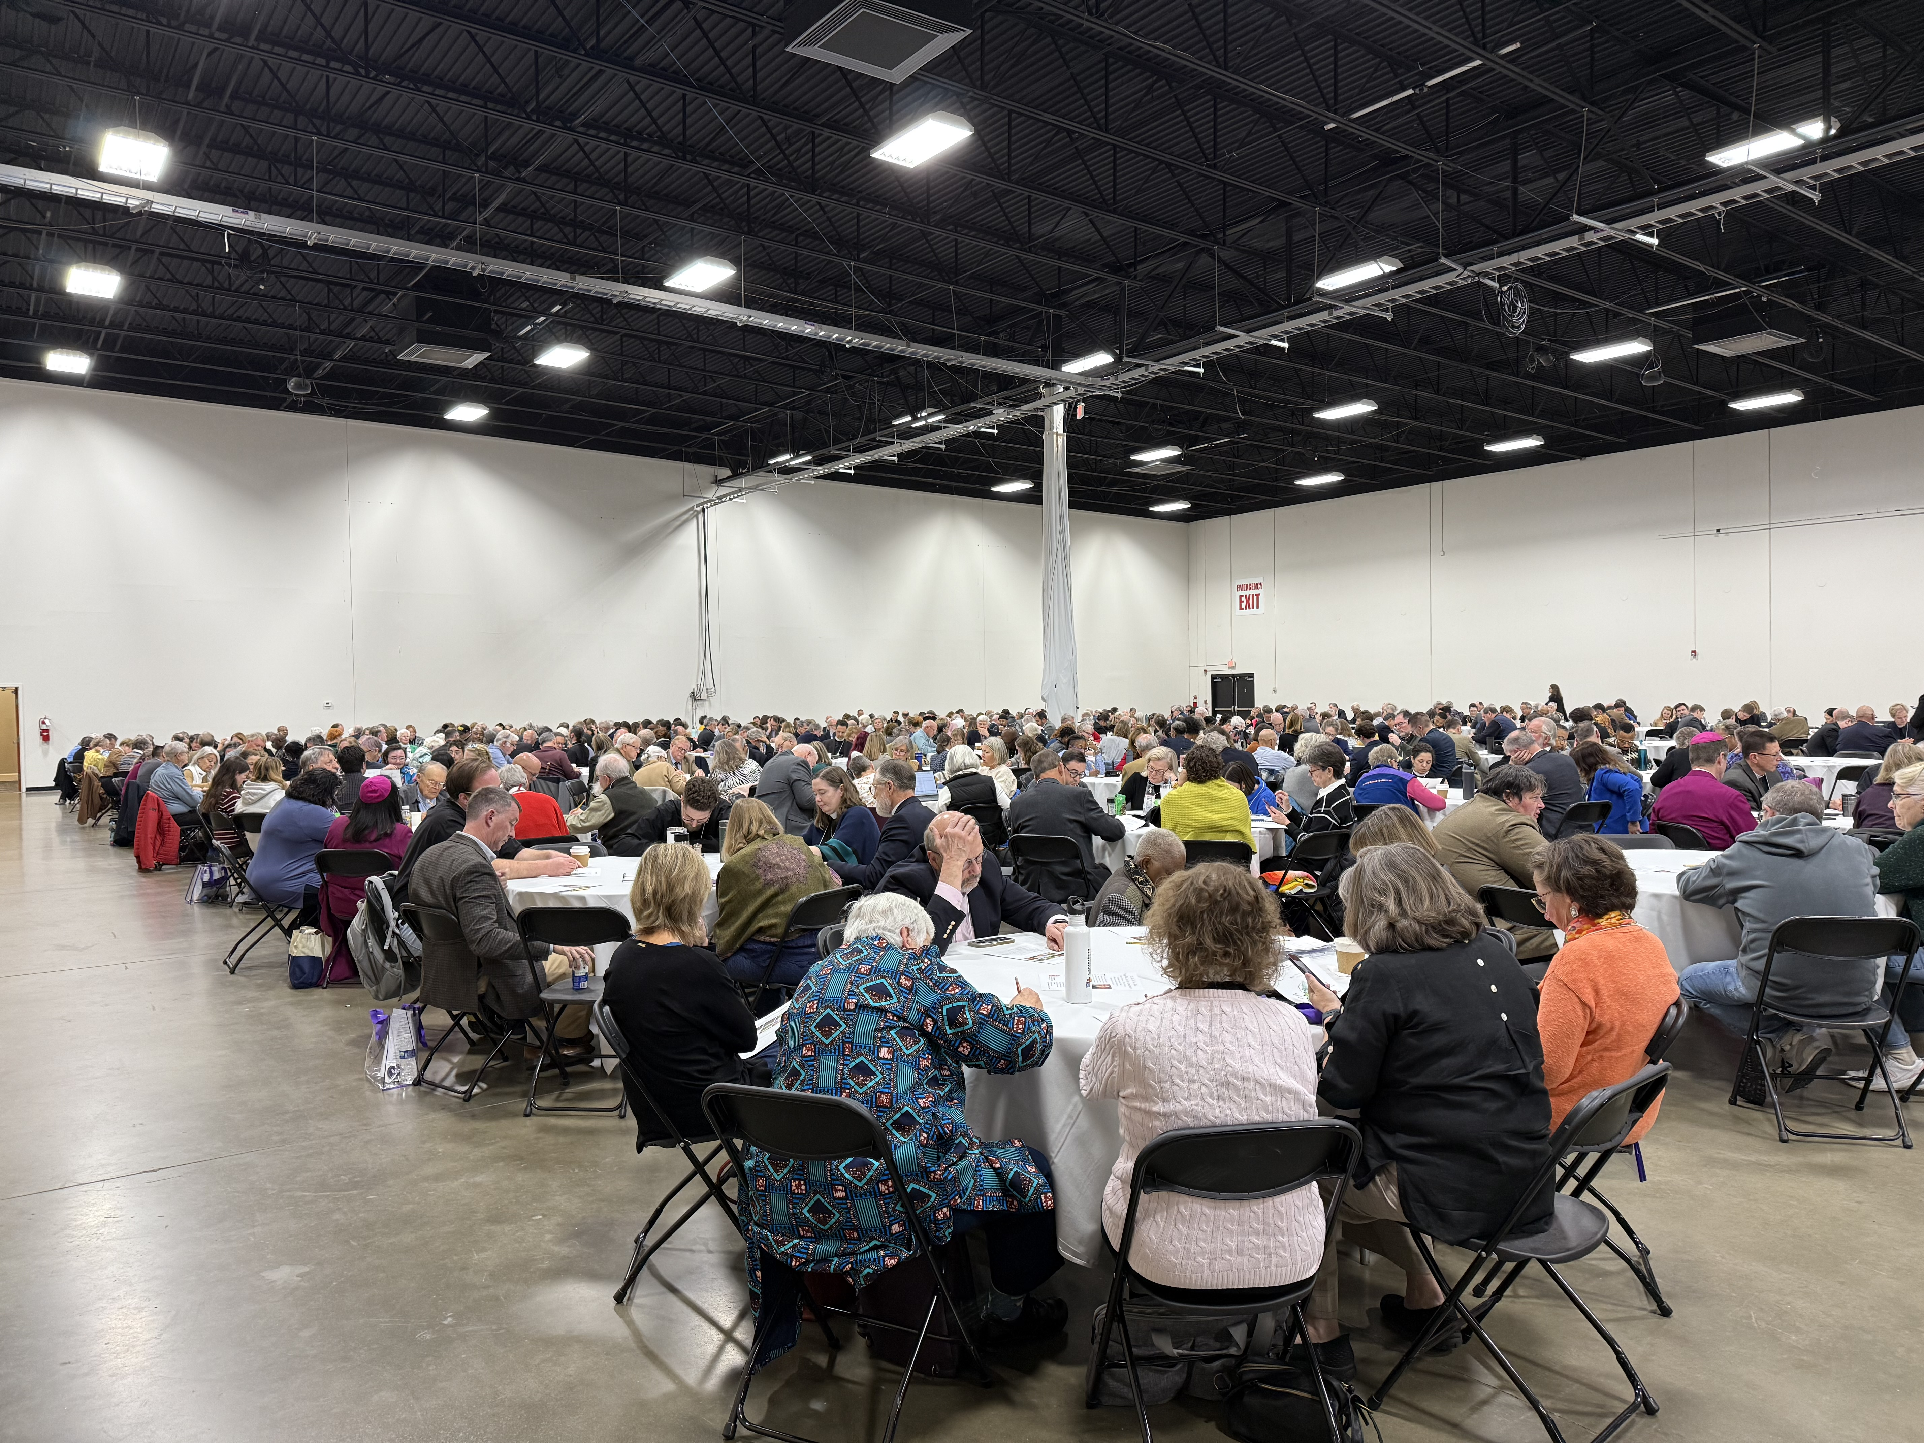
LECTIONARY+ LITURGY + LIFE

Slide 64
Discipleship Process*
Inquiry
Rite of Welcome
Formation
Rite of Enrollment
Intense Preparation
Baptism, Confirmation, Reception, Reaffirmation
Baptismal Living
Celebration of Vocation
Beginnings of faith
Scripture, Community
Liturgy, Mission
Prayer and Discernment
Reflecting on
Sacramental Experience
*Adapted from the catechumenate
A Journey in faith that takes as long as it takes;
lay led and supported by sponsors.

Slide 65
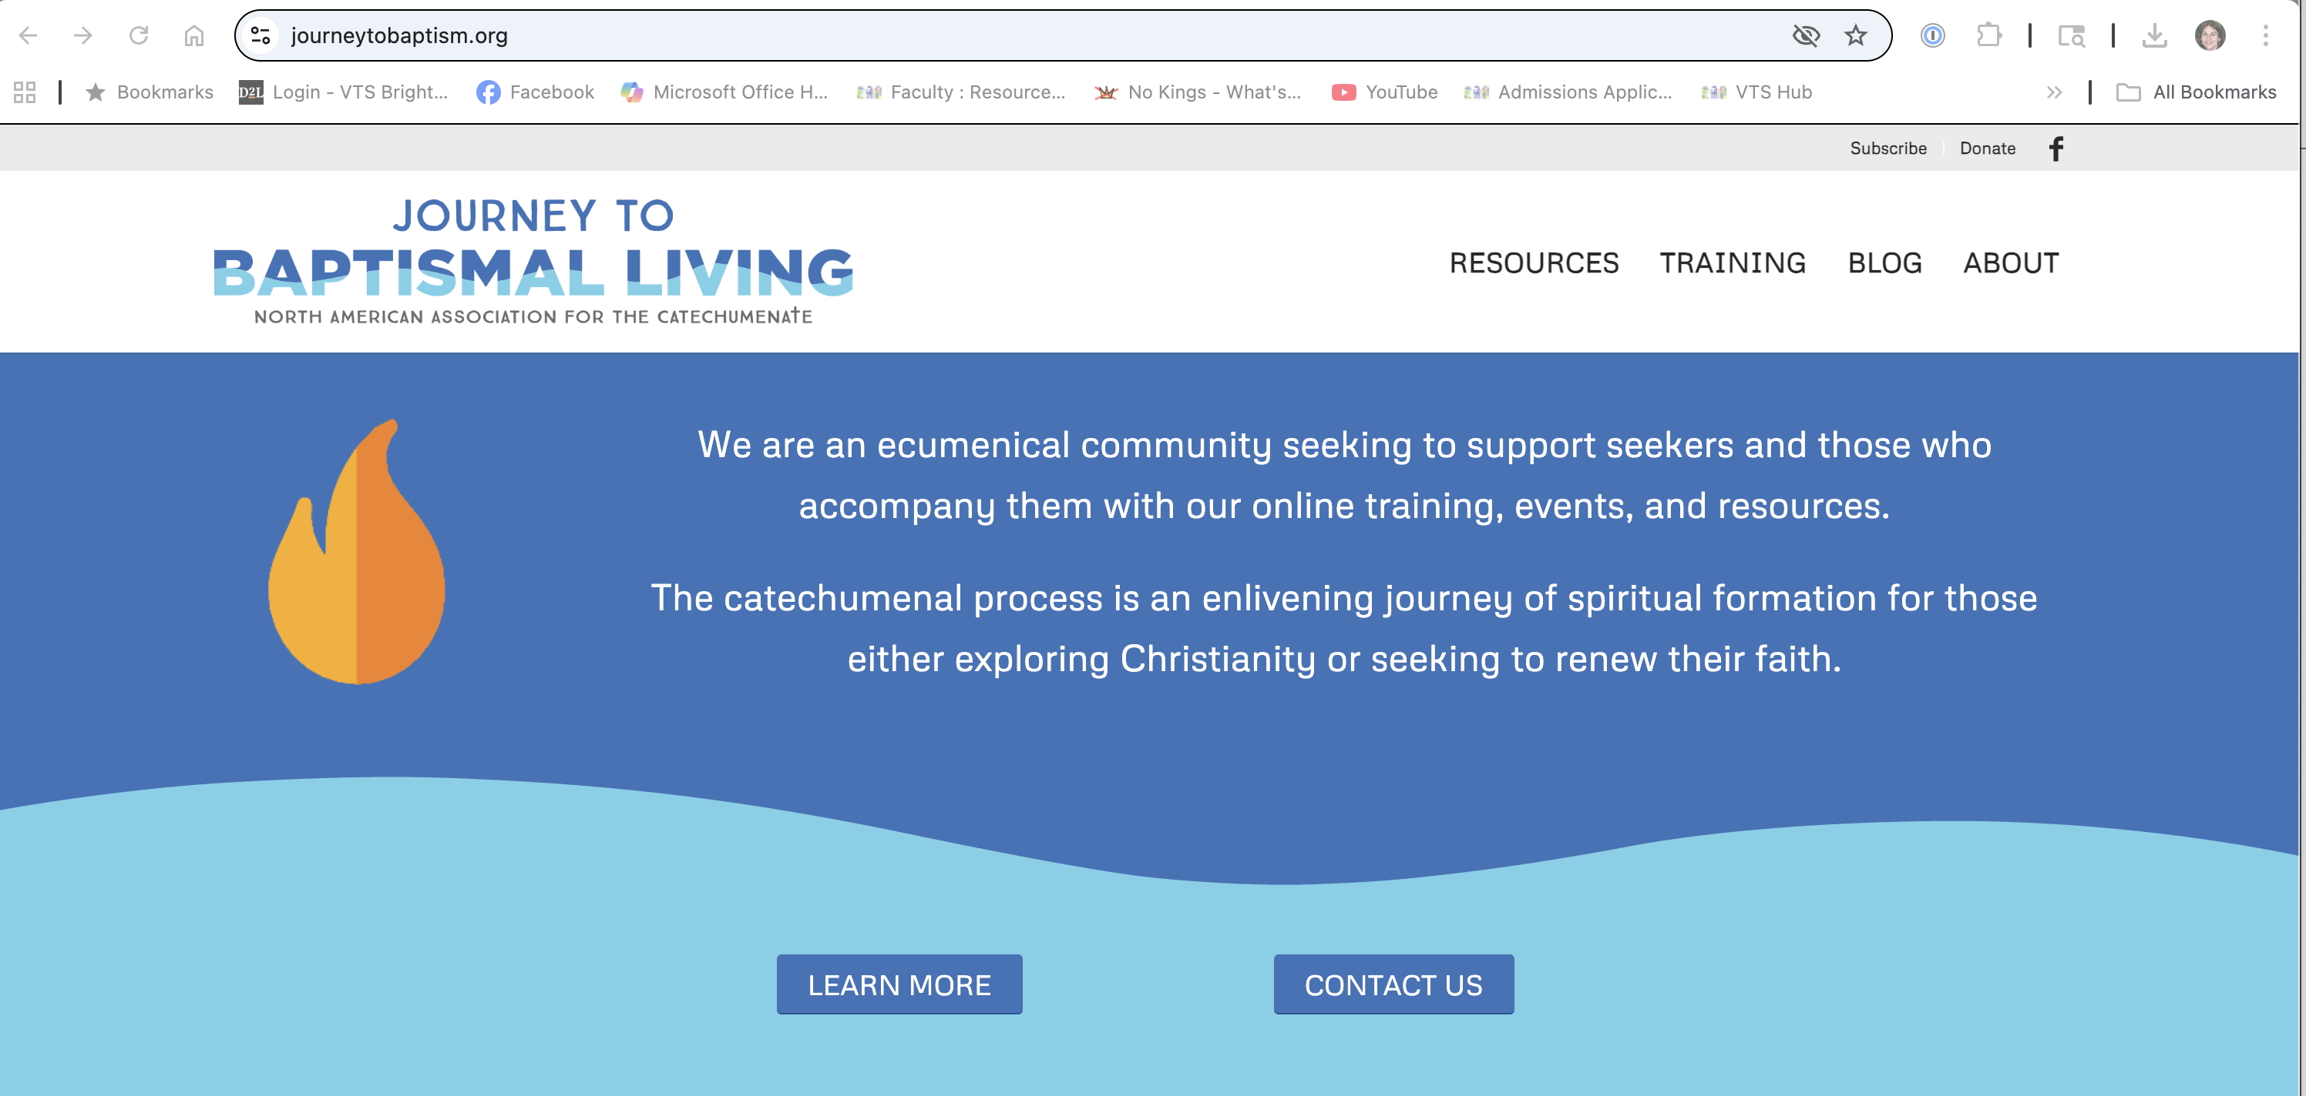

Slide 66
Irenaeus, c. 125 – c. 202 AD
“The glory of God is the [man] human fully alive.”
Photo Credit: Catholic Faith & Reason

Slide 67
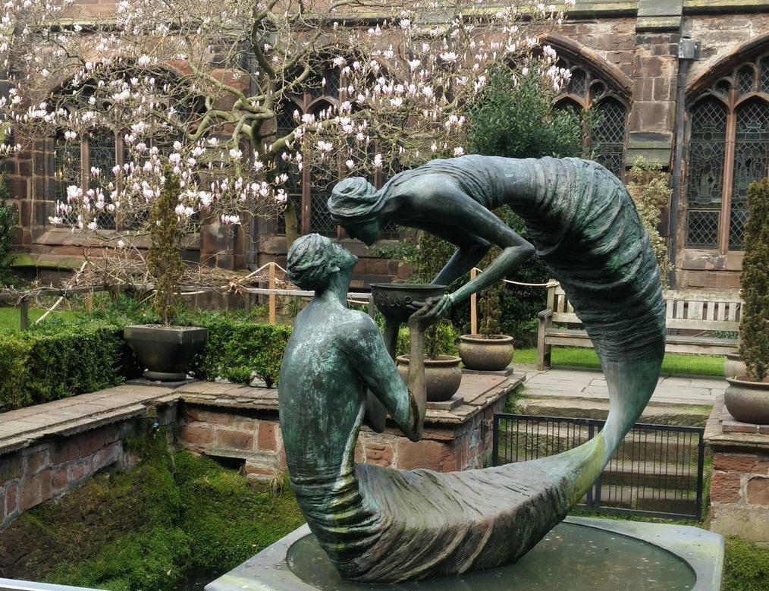
Water of Life:
Stephen Broadbent – Chester Cathedral

Slide 68
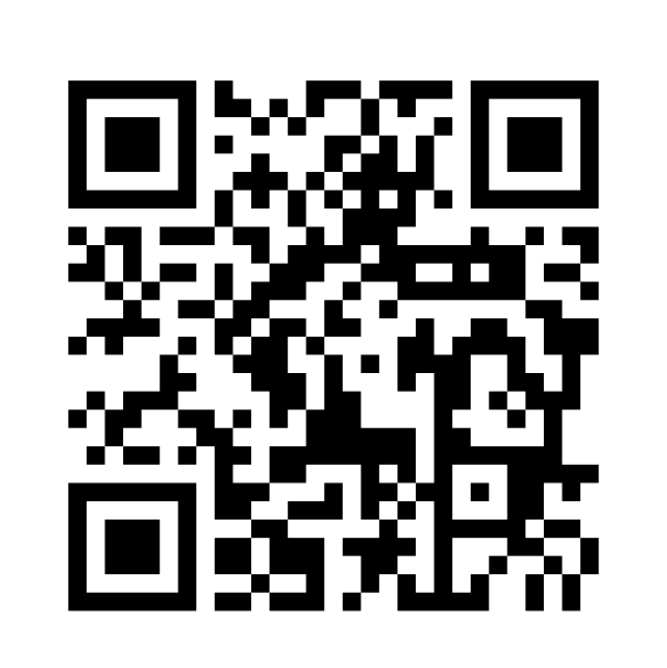

Baptized for Life!
Resources
for the journey –
Lifelong Learning at VTS

